Slide 1
Leveraging Large Data Sets to Make Connections in Intro Stats
Michael Sullivan
sullystats@gmail.com
Michael.Sullivan@fsw.edu
https://www.sullystats.com

Slide 2
Agenda
Data from *.csv files
Data via webscraping
Data using SAS viewer
https://sullystats.github.io/Data/Leveraging.pptx

Slide 3
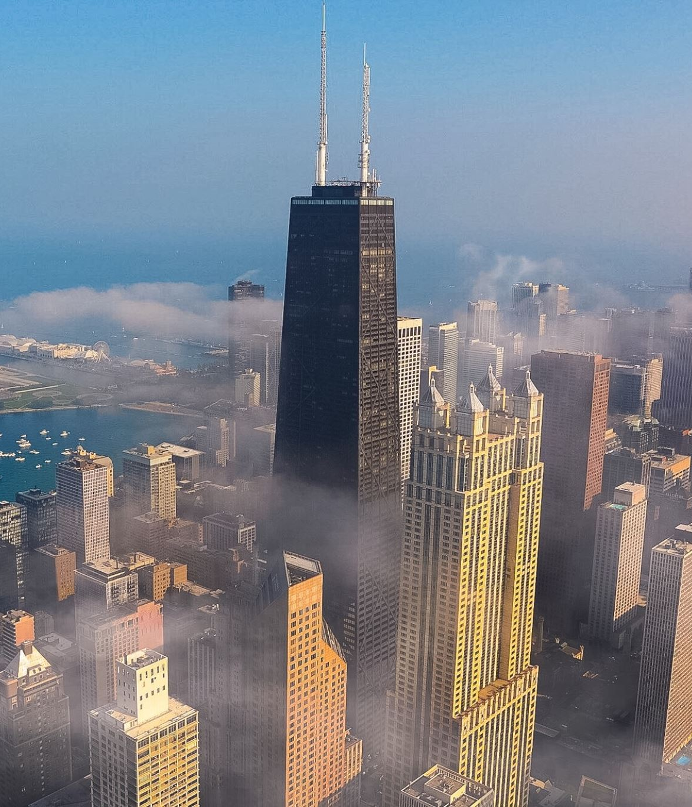
City of Chicago Data Portal
https://data.cityofchicago.org/

Slide 4
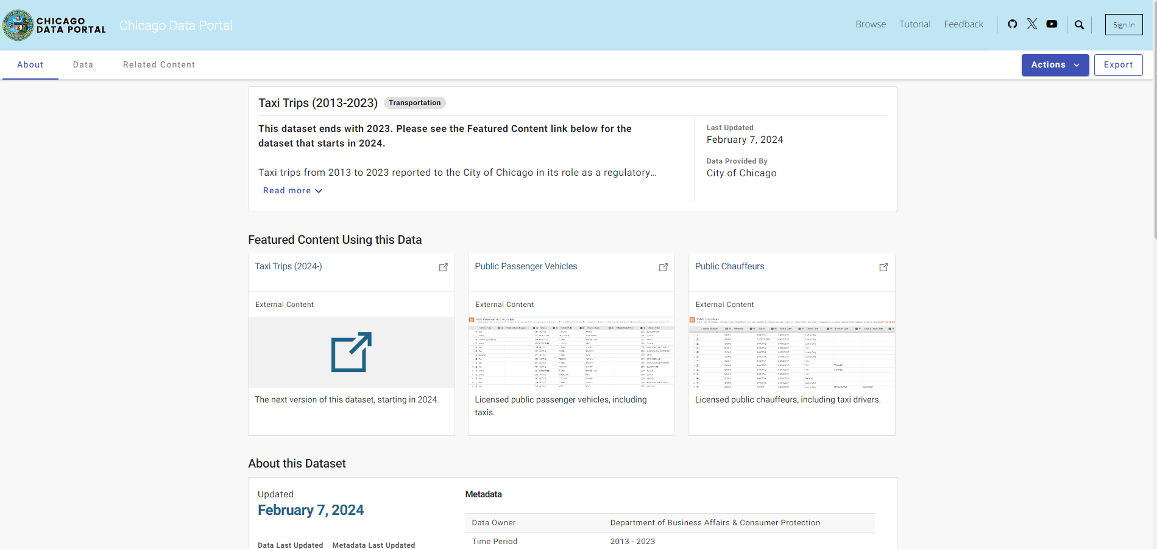

Slide 5
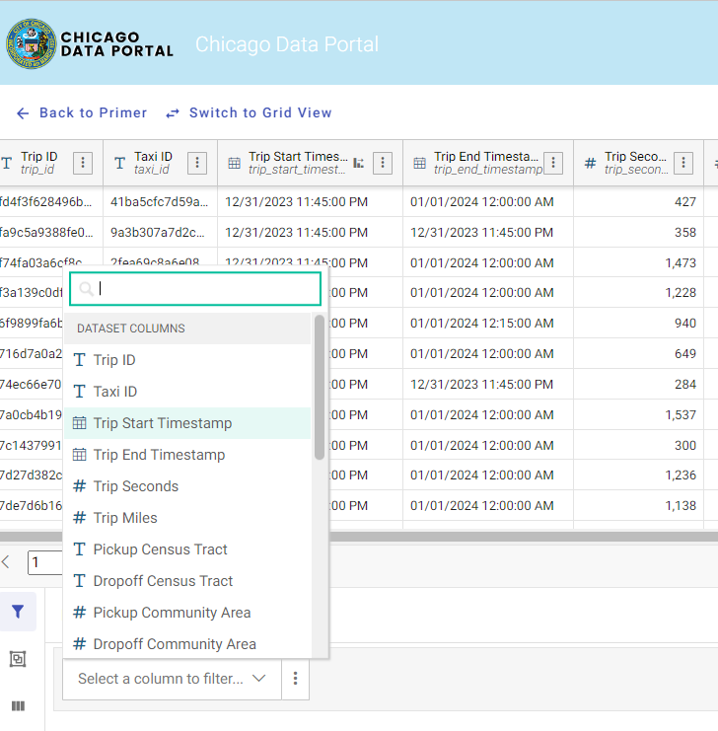

Slide 6
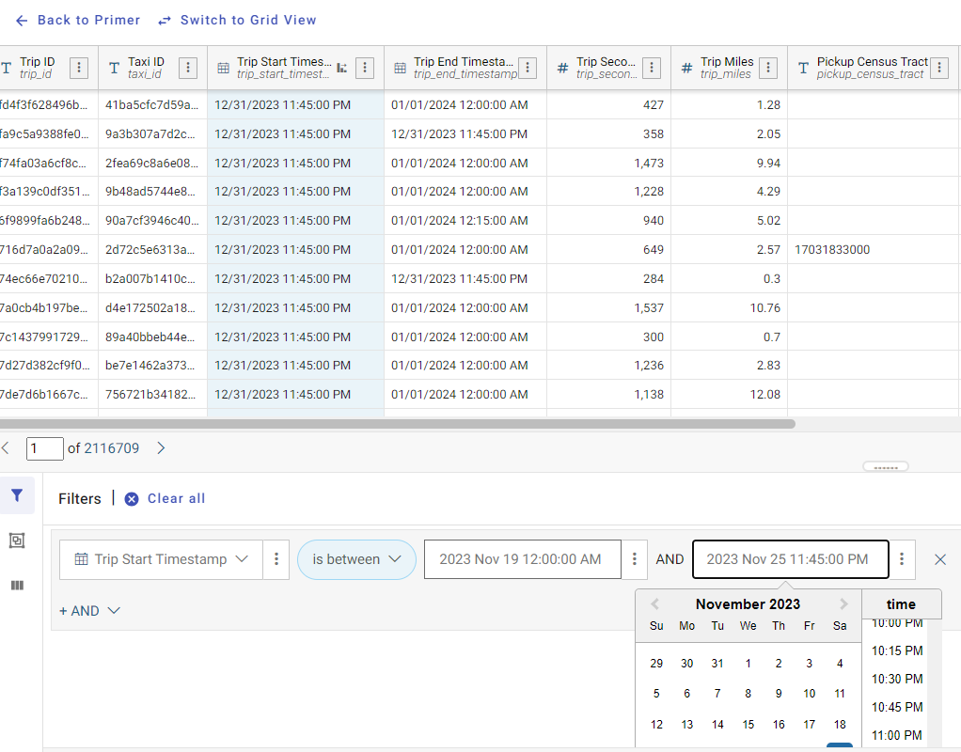

Slide 7
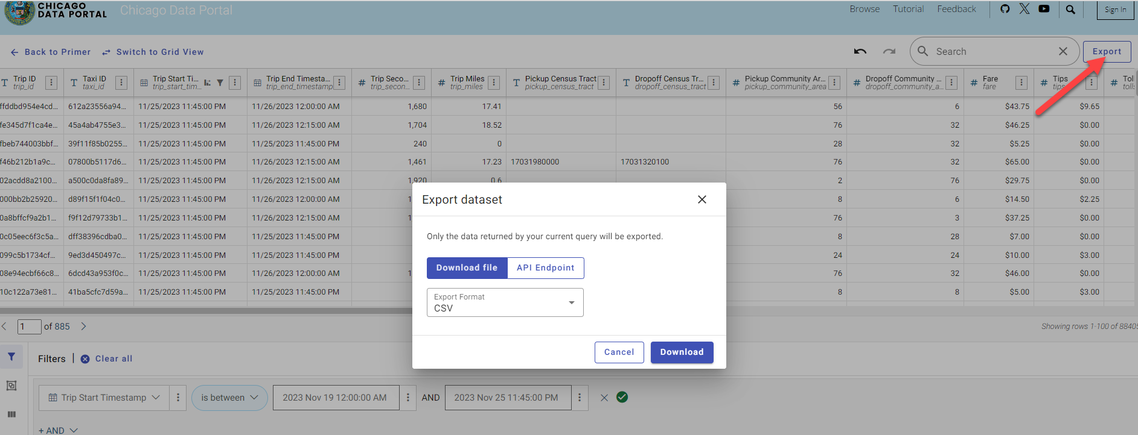

Slide 8
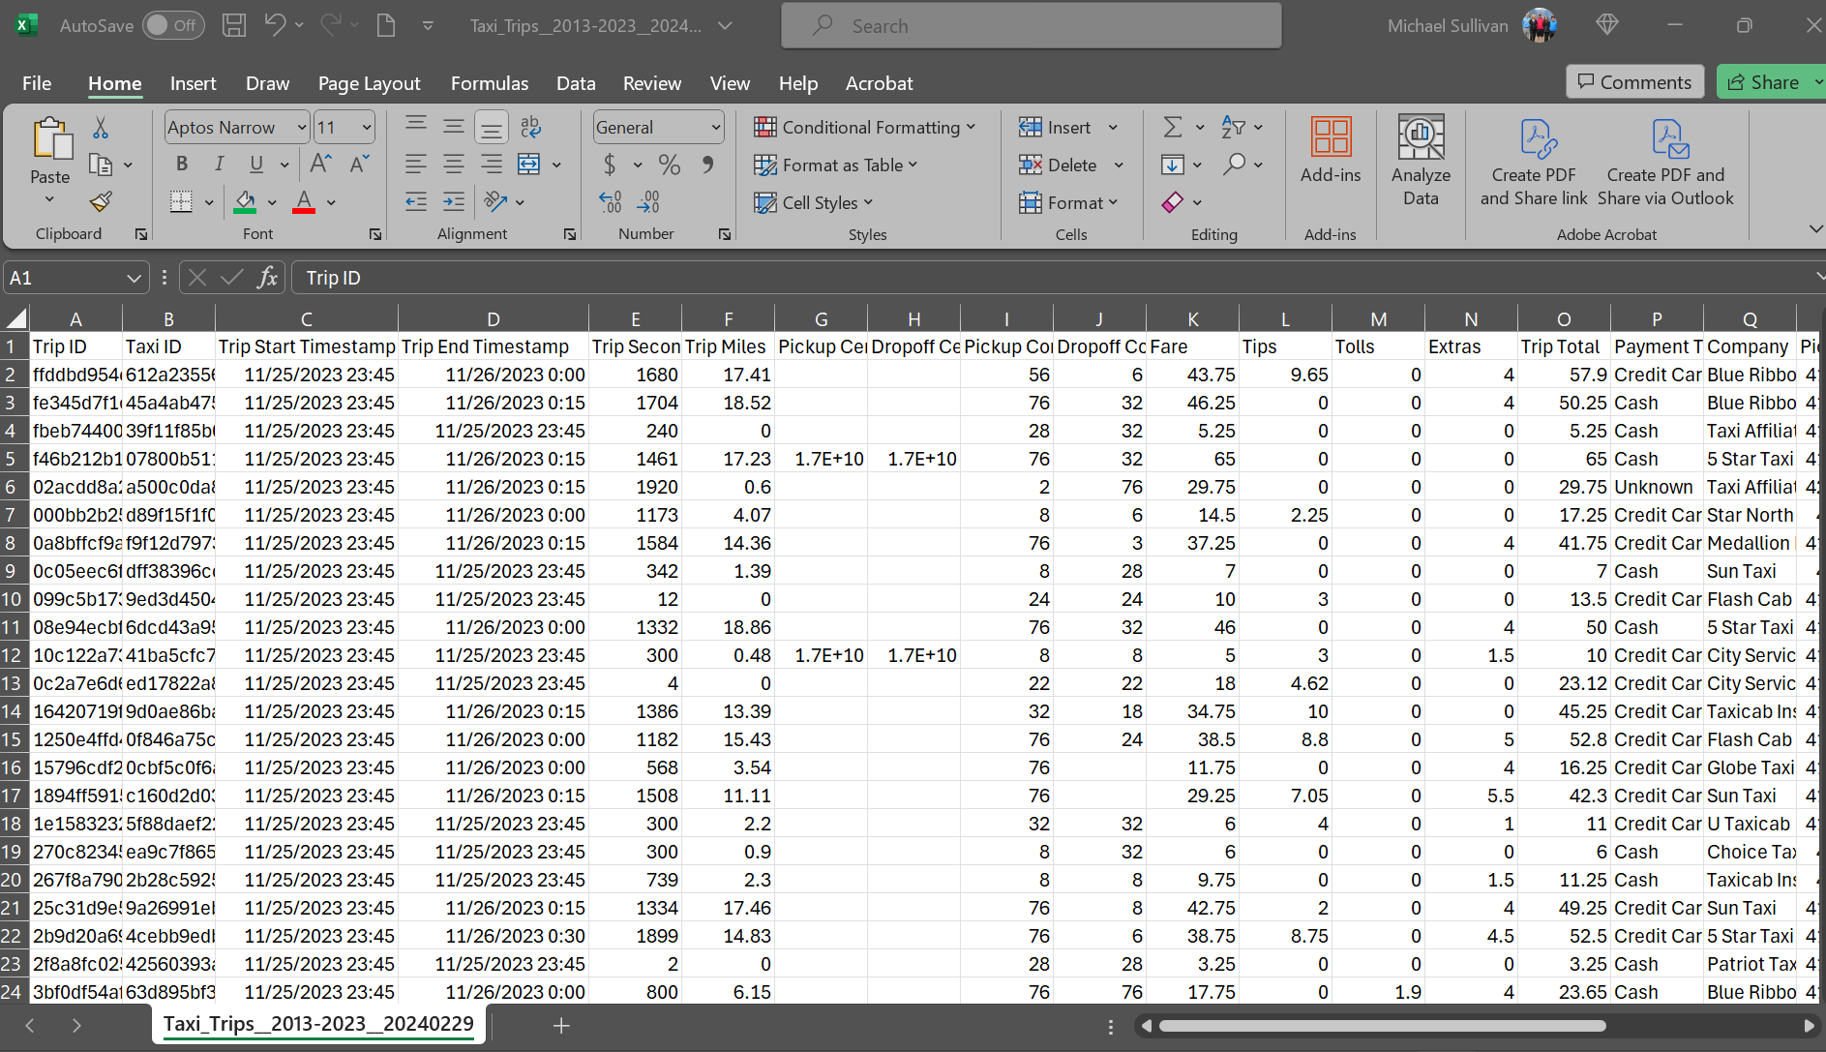
Notes:
Remove any variables you don’t want.

Slide 9
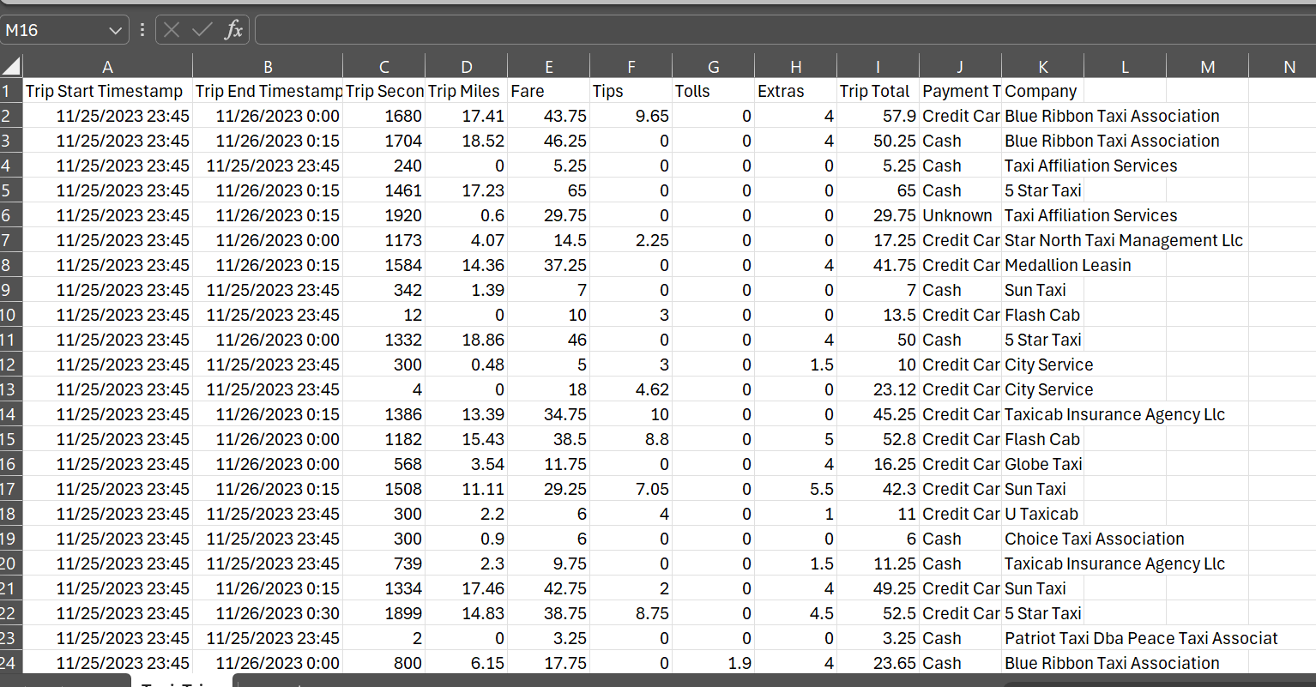
This data is available at
https://sullystats.github.io/Data/Taxi_Trips.csv

Slide 10
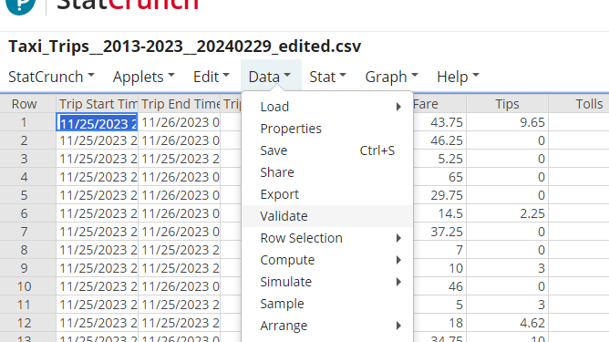

Slide 11
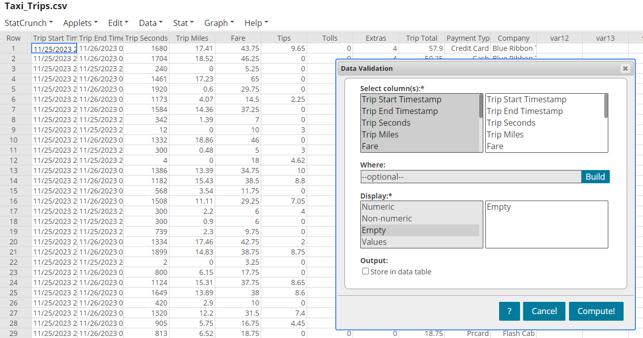

Slide 12
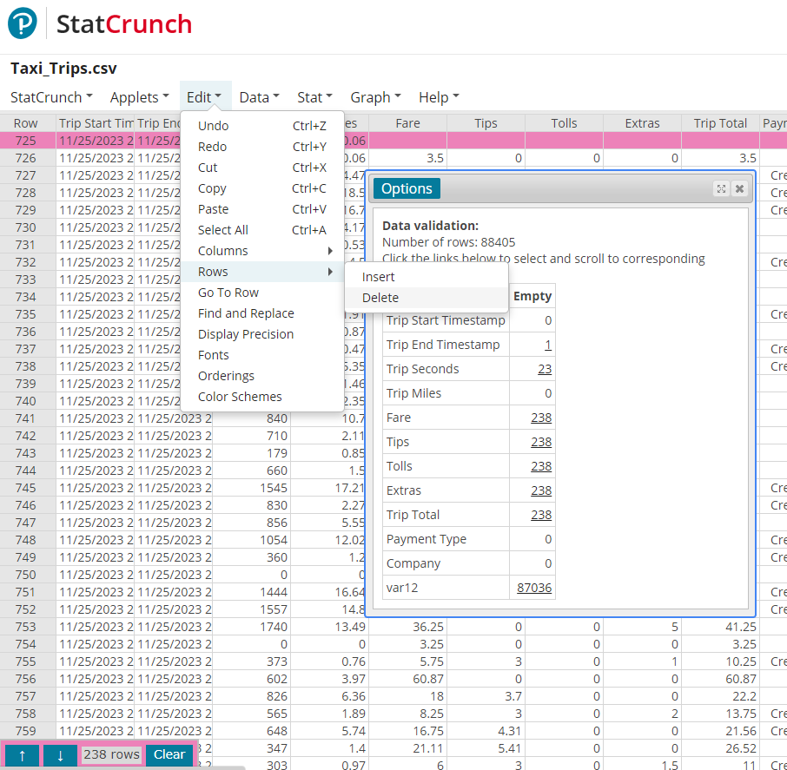

Slide 13
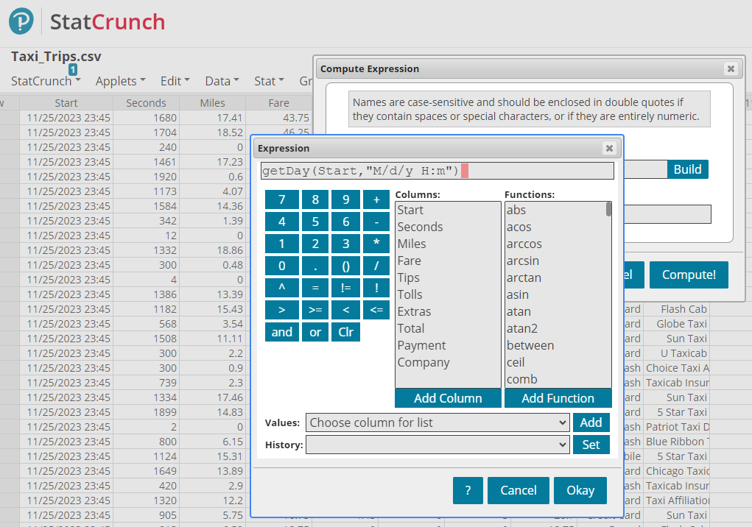

Slide 14
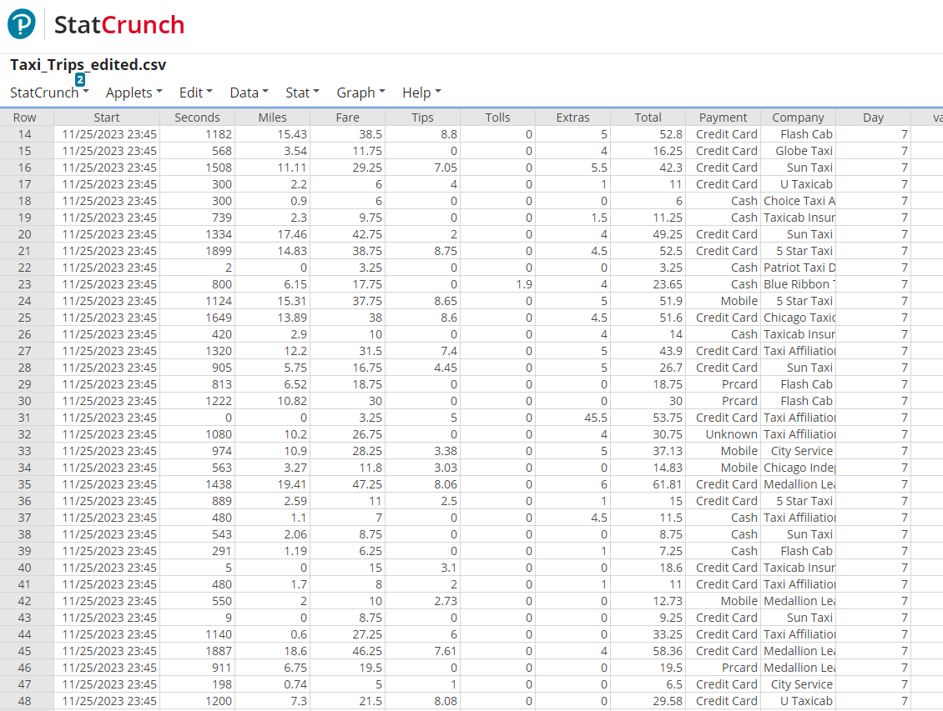
https://sullystats.github.io/Taxi_Trips_edited.csv

Slide 15

Statcrunchthis!
https://www.sullystats.com/statistics-videos

Slide 16
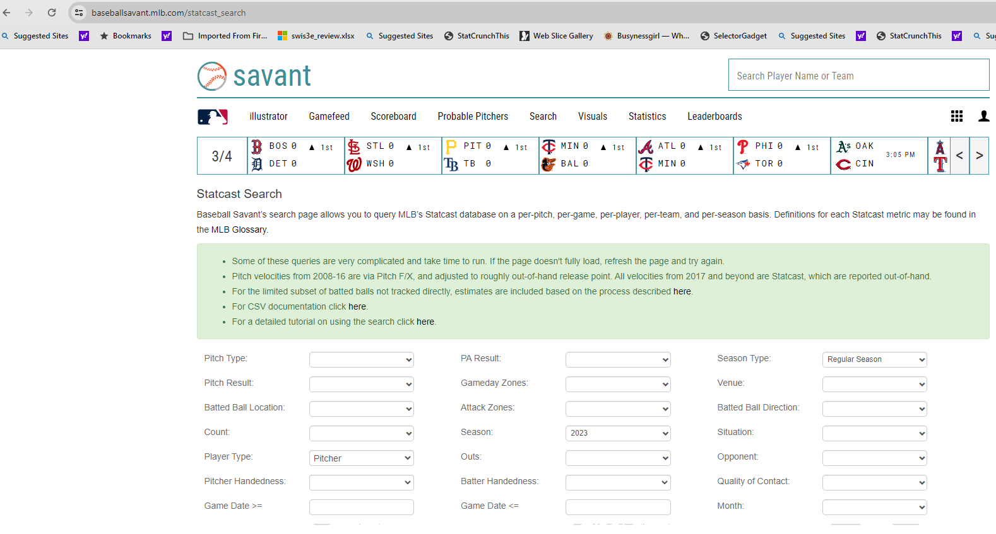
Baseballsavant.mlb.com/statcast_Search

Slide 17
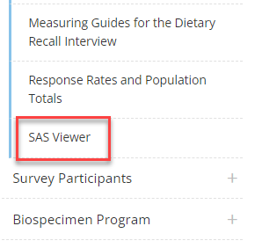
SAS Viewer
cdc.gov/nchs/nhanes/
Notes:
From the NHANES website, scroll down to the SAS Viewer. Click on the SAS Viewer link. Scroll to download the free SAS viewer. Download the latest version. You will need to create a profile on their website. Click setup after extracting the zip folder.

Slide 18
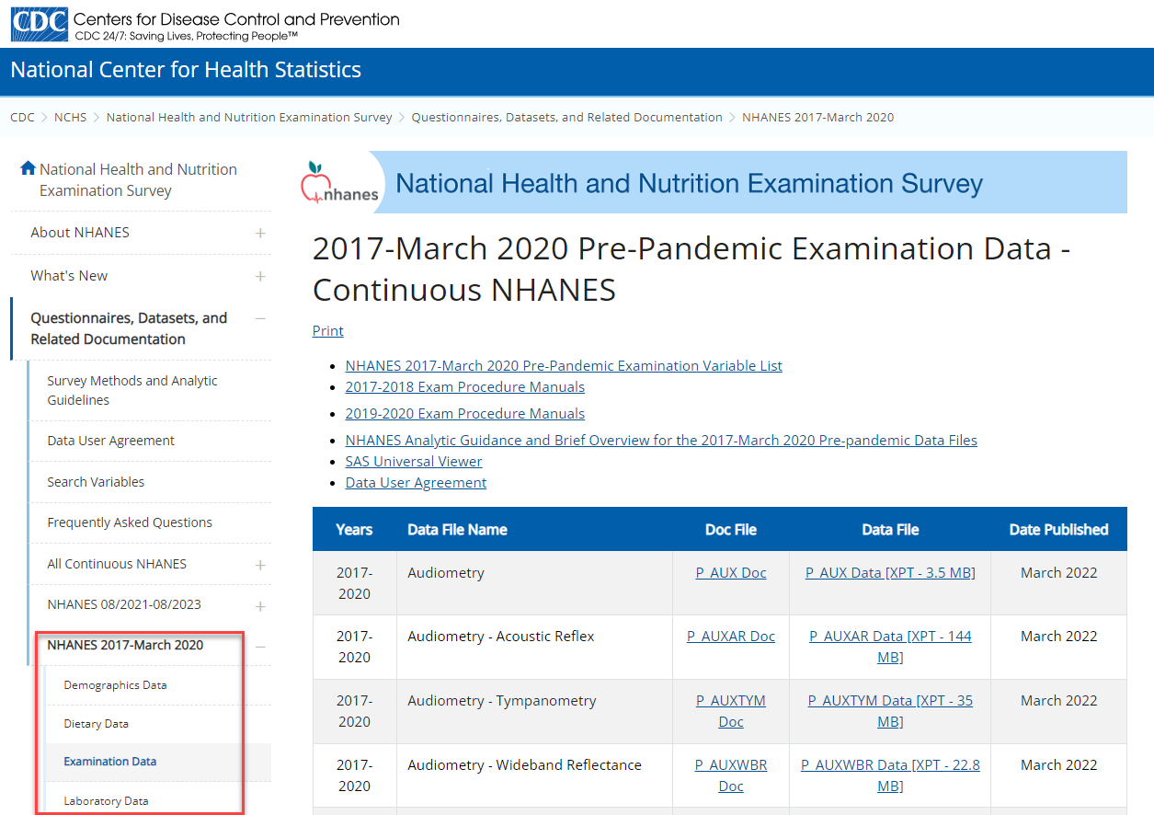
Centers for disease control and prevention (CDC)
wwwn.cdc.gov/Nchs/Nhanes/
Notes:
Select the 2017-March 2020 Pre-pandemic survey. We are going to obtain the demographic data, dietary data (dietary interview-total nutrient intakes, first day), and examination data (body measures).

Slide 19
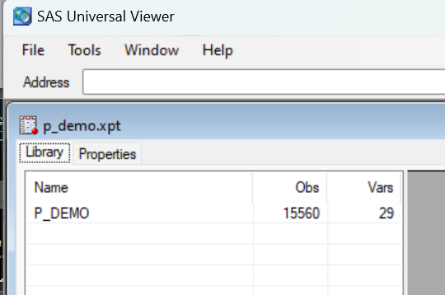
P_DEMO.xpt
Notes:
Double-click the P_DEMO.XPT file.

Slide 20
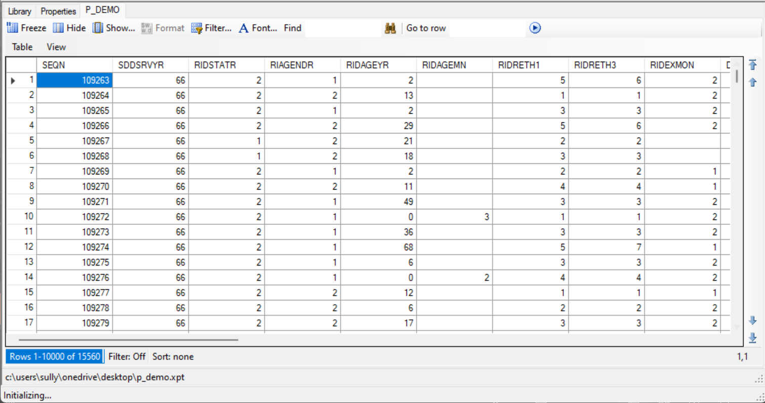
Notes:
Click Table

Slide 21
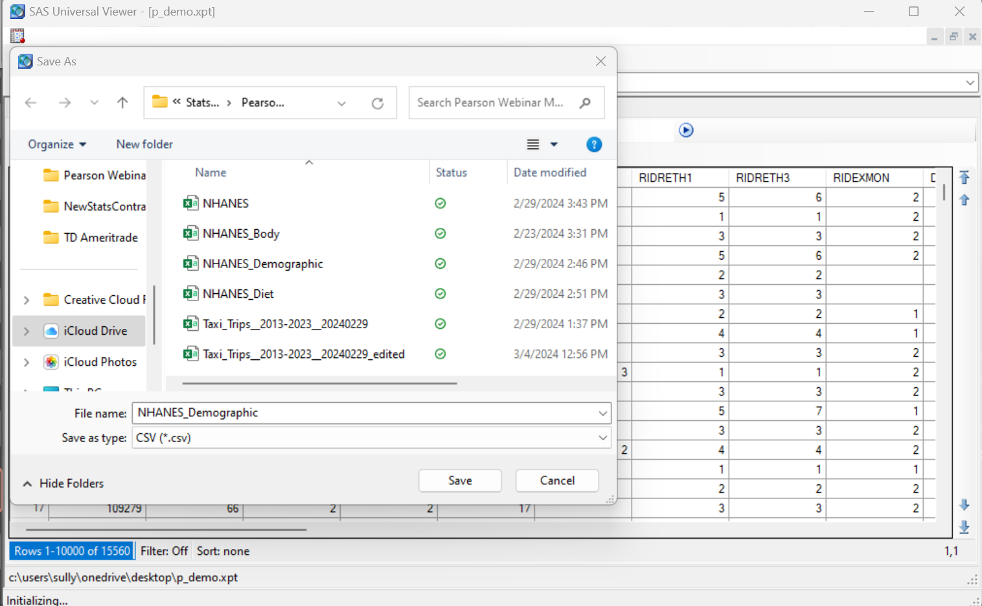
Notes:
Click Table > Save as and set type to CSV. Give the file a name such as NHANES_Demographic Repeat this for the other XPT files.

Slide 22
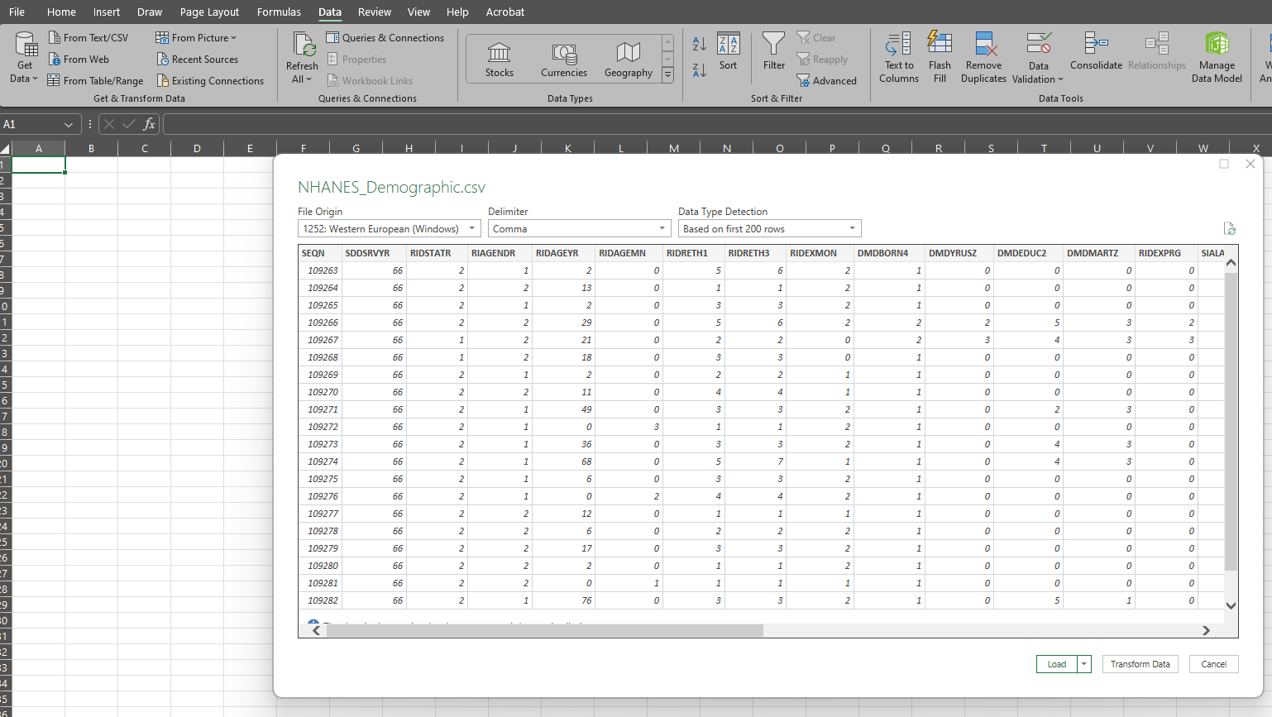
Notes:
Select Data > Get Data > From File > From Text/CSV. Select Demographic csv file. Click Load to…

Slide 23
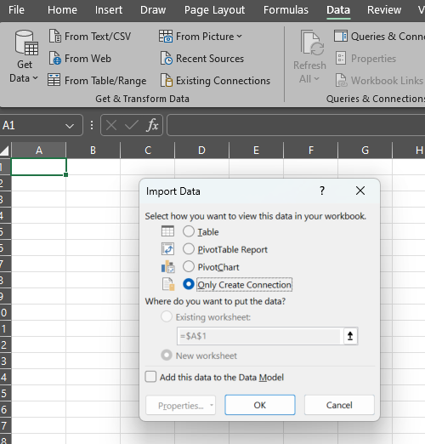
Notes:
Choose “Only Create Connection”.

Slide 24
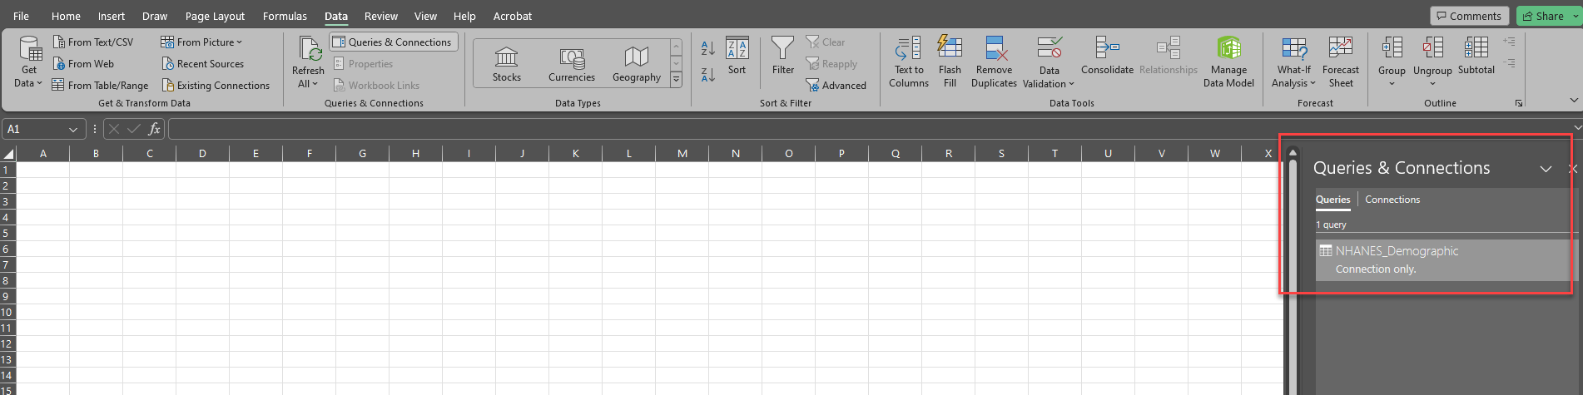
Notes:
Notice the NHANES_Demographic data appears as a connection only.

Slide 25
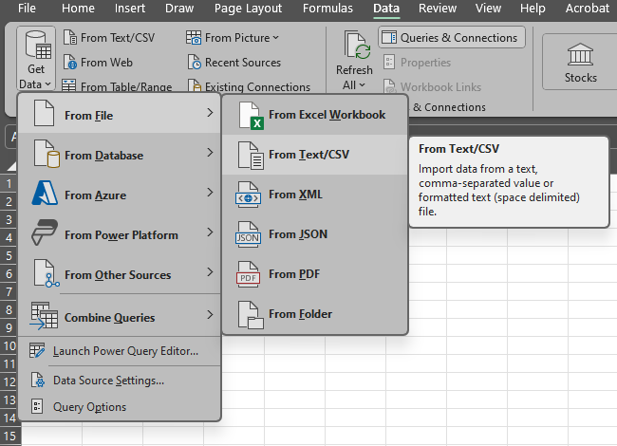
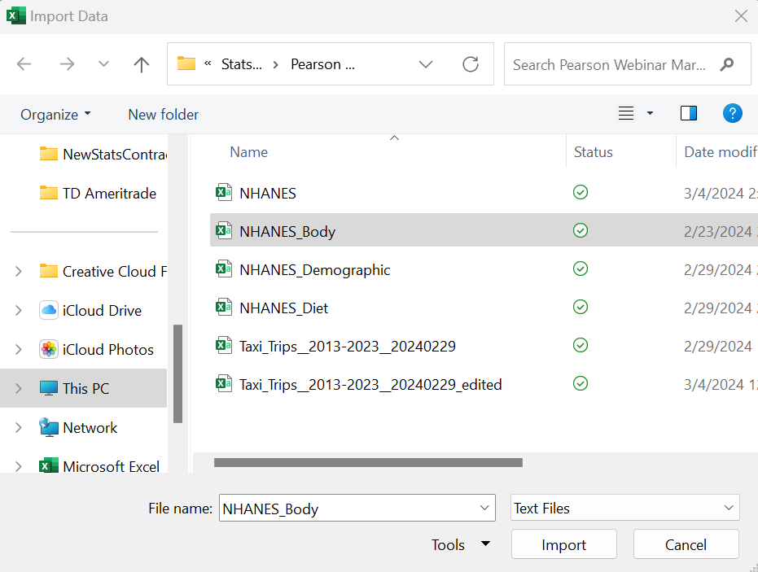
Notes:
Now select Data > Get Data > From File > From Text/CSV Select the NHANES_Body file

Slide 26
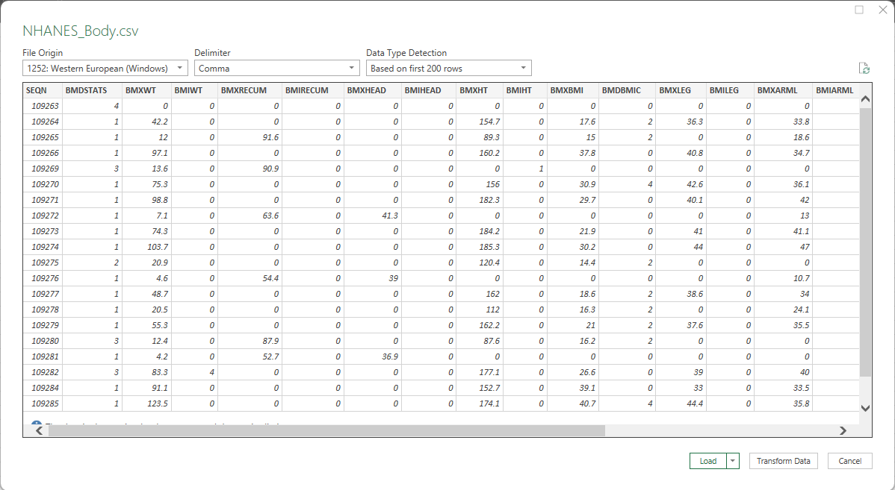
Notes:
Select Load to…

Slide 27
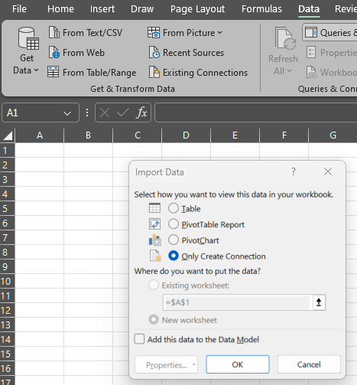
Notes:
Choose “Only Create Connection” click OK. Repeat this for the Diet data.

Slide 28
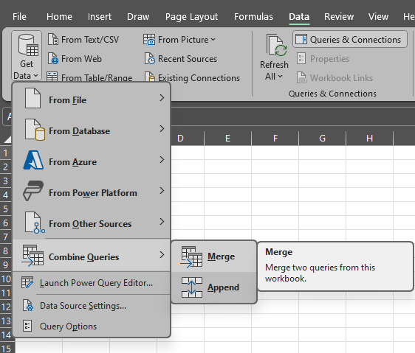
Notes:
Now we want to merge the files into a single file. We will do this in two stages. First, we will merge the Demographic data with the Body data. Once that is complete, we will merge the Diet data into the merged data frame.
Select Data > Get Data > Combine Queries > Merge

Slide 29
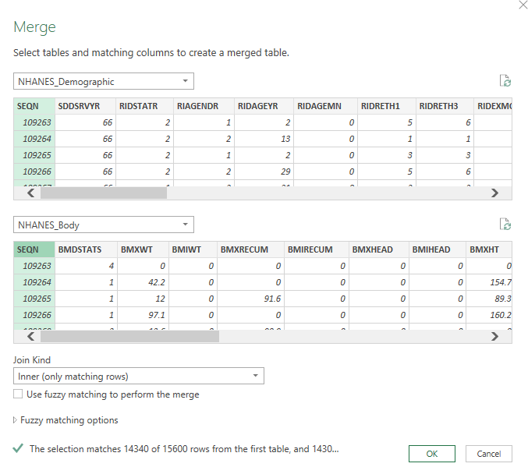
Notes:
We will merge by SEQN, which is the number associated with each study participant. Select “Inner” under Join Kind so we only grab the matching rows. Notice that 14340 of the 15600 rows in Demographic data frame match. Click OK.

Slide 30
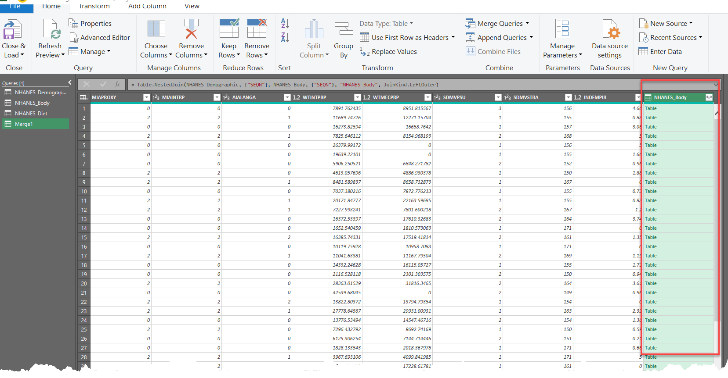
Notes:
The right-most column contains the data for the Body data frame. Click the icon next to the header to extract the columns for that data frame. Decide which variables you want included. To do this we go to the word file that describes the variables in the data frame.

Slide 31
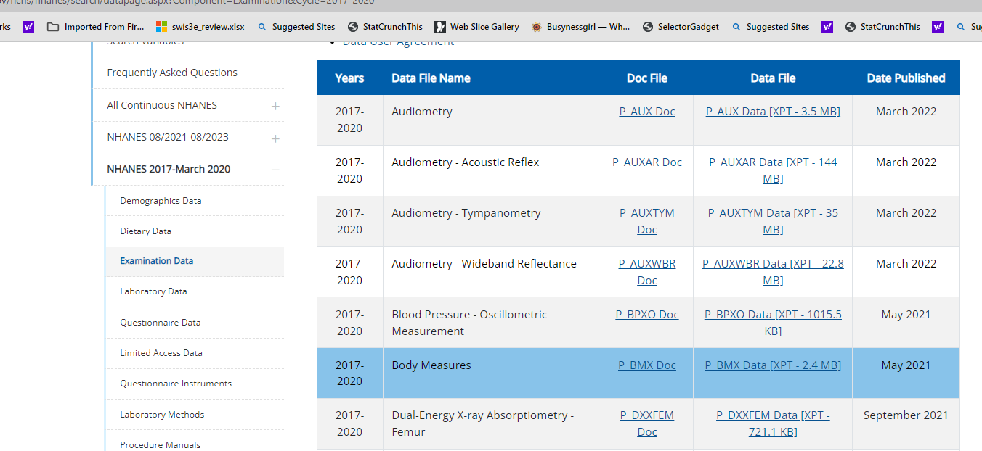
Notes:
Click P_BMX.Doc to open the data documentation and codebook.

Slide 32
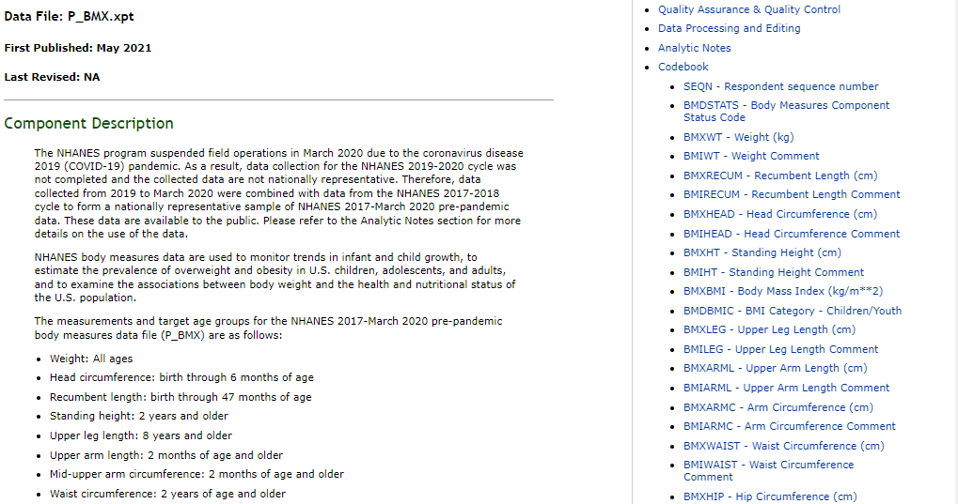

Slide 33
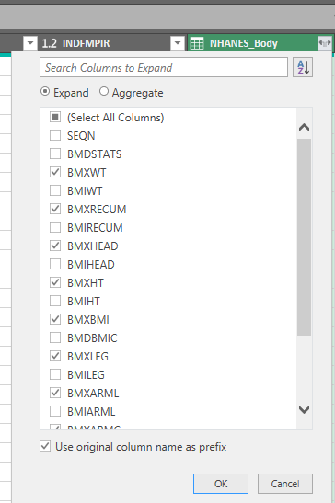
Notes:
Select the body measurements desired and click OK. Then, click Close and Load.

Slide 34
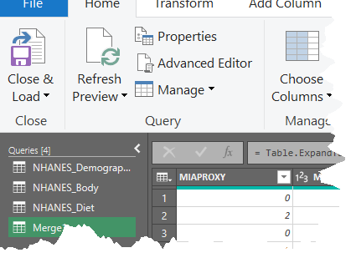
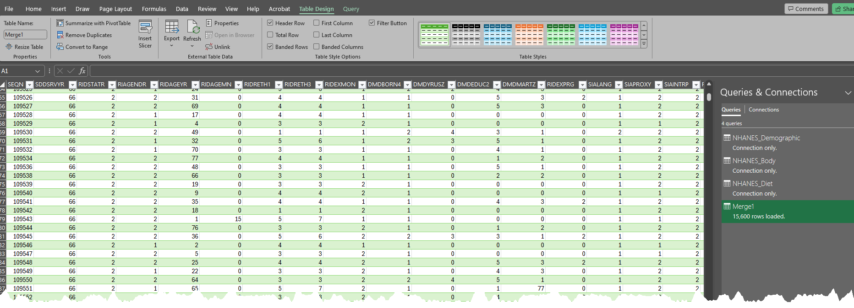
Notes:
Click Close and Load to create the data frame of the merged files. Repeat this process for the Diet data.

Slide 35
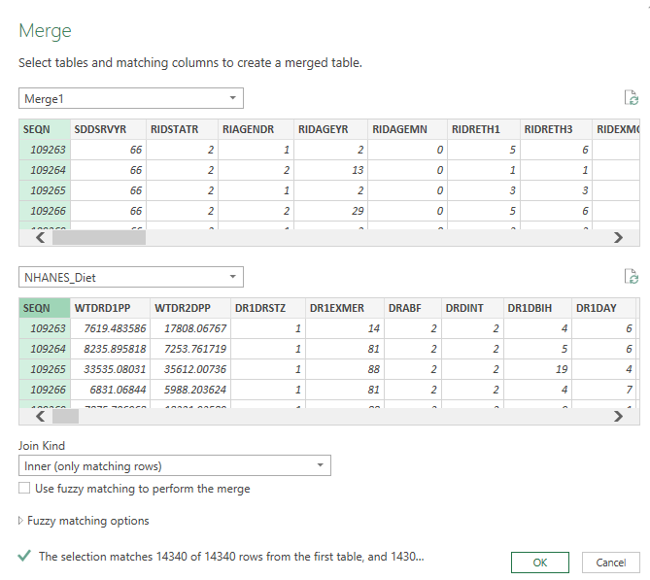
Notes:
Again we do inner matching. Click OK.

Slide 36
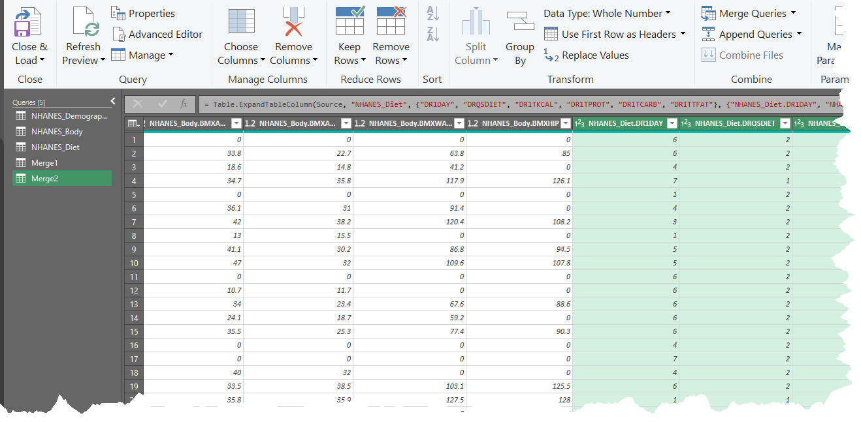
https://sullystats.github.io/Data/NHANES.csv
Notes:
Choose variables from the Diet Table. Click Close & Load. Save the file (NHANES_Webinar).

Slide 37
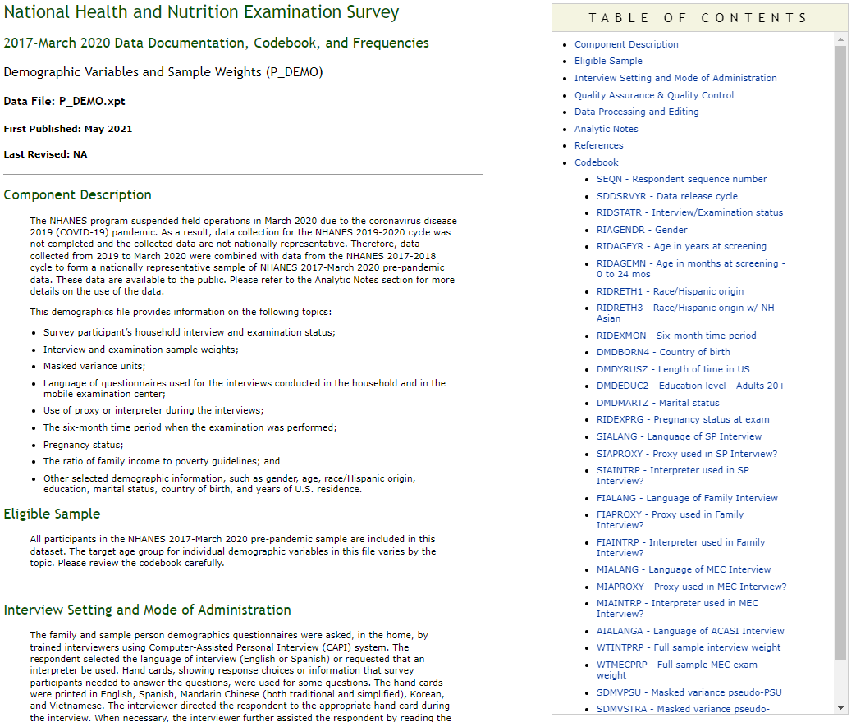
Notes:
Now we need to clean up the column heads for our variables by renaming the variables based on the codebook. We also may delete unwanted variables (such as data release cycle).

Slide 38
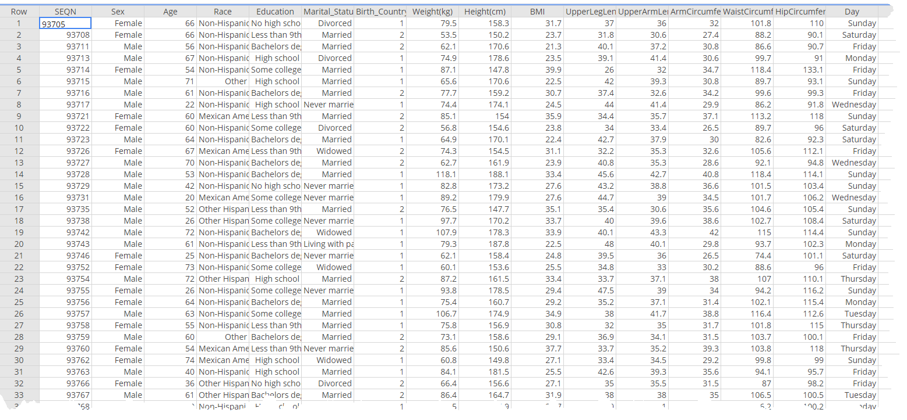
https://sullystats.github.io/Data/Health.csv
Notes:
Okay. Let’s use a different NHANES file that I have and answer a few questions.

Slide 39
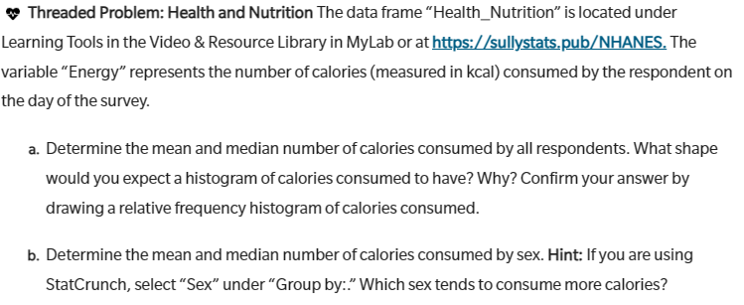

Slide 40
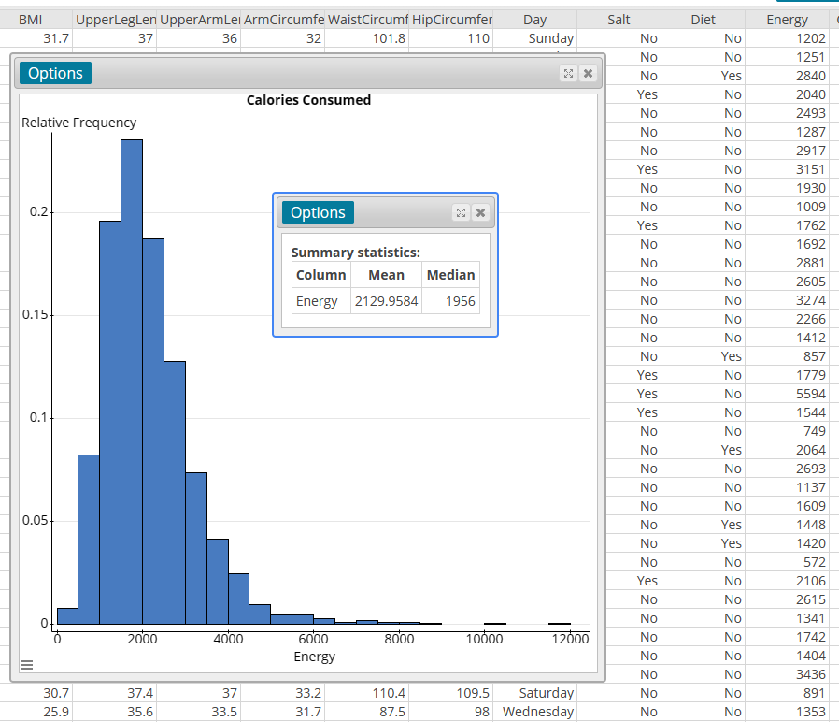
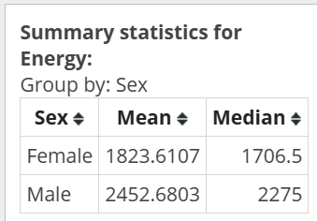

Slide 41
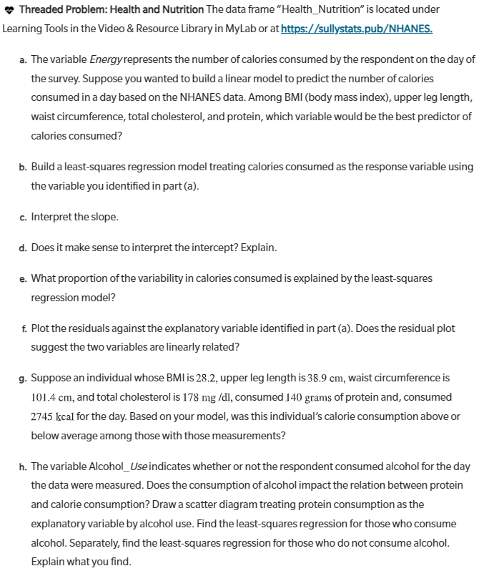

Slide 42
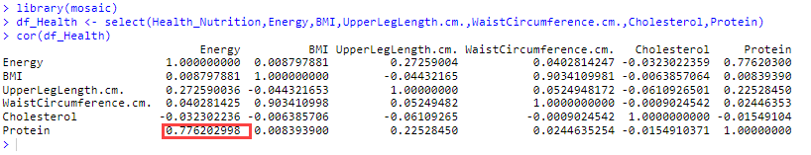
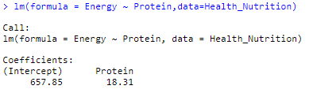

Slide 43
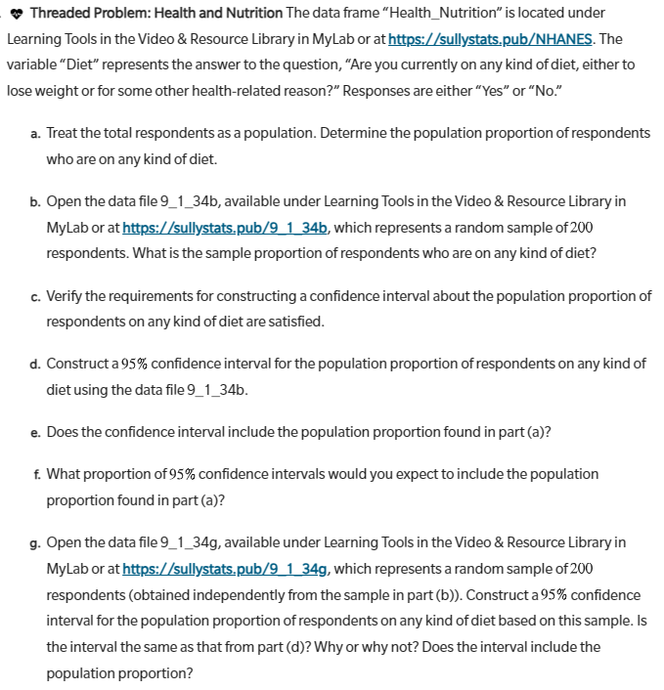

Slide 44
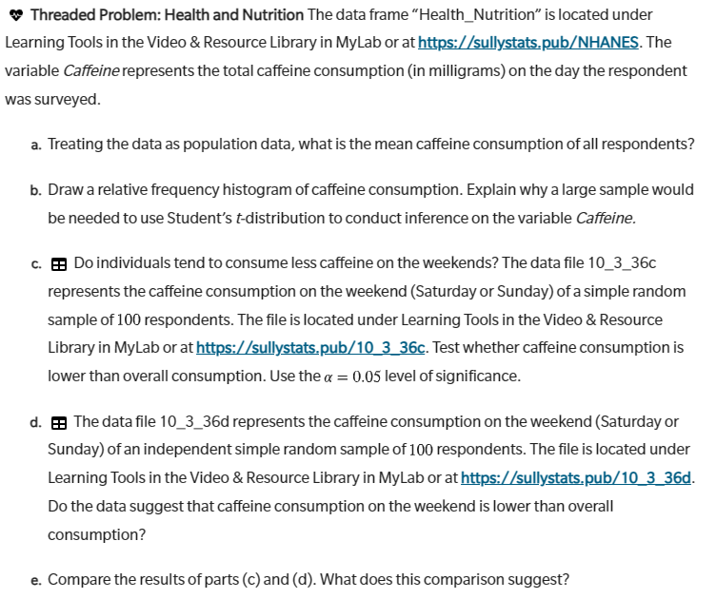

Slide 45
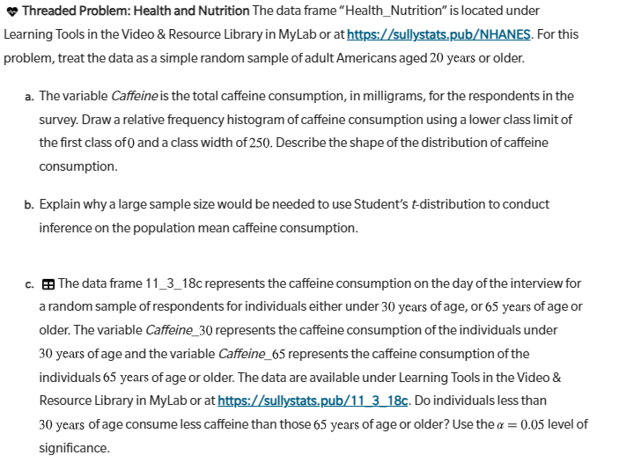

Slide 46
THANK YOU
Michael Sullivan​
sullystats@gmail.com
michael.sullivan@fsw.edu
https://www.sullystats.com

